Slide 1
BIRCHWOOD PROJECT

Slide 2
PROJECT OVERVIEW
Developing an application for the Birchwood company that allows users to buy and sell boats and boat related services.

Slide 3
PROJECT VISION
To develop a cloud hosted platform with seamless user experience and can handle the entirety of birchwood’s product listings

Slide 4
PROJECT OBJECTIVES
CUSTOMER
BOAT OWNER
THIRD PARTY VENDORS
Customer should rent or buy a boats
Boat owner should be able to sell boats
Third party vendors should be able to advertise boat related content. For example insurance, repair services

Slide 5
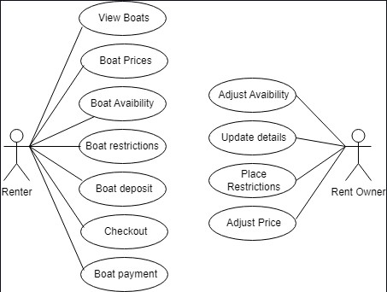
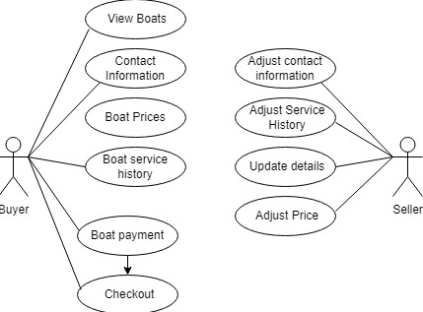
USE-CASE DIAGRAMS

Slide 6
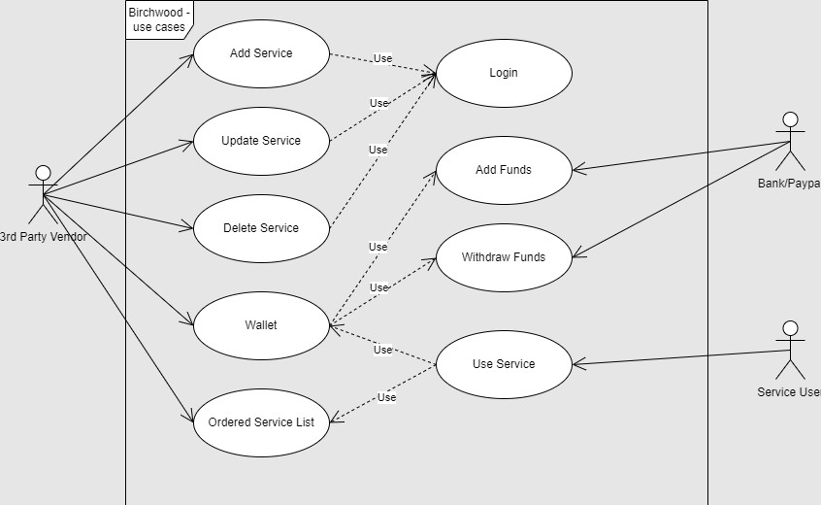
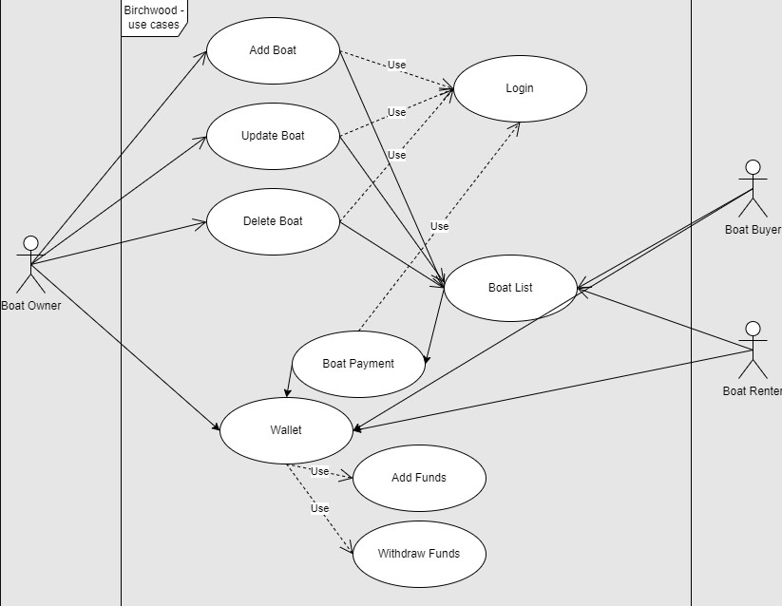
USE-CASE DIAGRAMS

Slide 7
SITEMAP [Boat owner]
Login
Sign-up
Dashboard
Promotions
Upload boat
Wallet
Notifications
Promote uploaded boats
Boats are listed by default but users pay for more visibility through promotions
*Pricing
*Discount
To be made to and from wallet system
Request promotion approval
Upload boat
Payment
Users would be asked to leave 5 star reviews on their experience on logout
Receive promotion confirmation
Logout

Slide 8
SITEMAP [Third party vendors]
Login
Sign-up
Dashboard
Upload products
Promotion service
Referrals
Wallet
Notifications
Manage pricing
Promotions

Slide 9
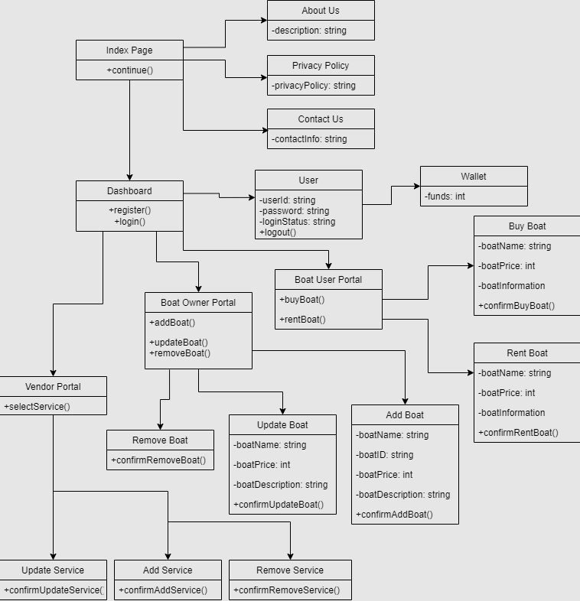
CLASS DIAGRAM

Slide 10
COMMUNICATION PLAN
Communication objectives – Addressing the issues and concerns on the project in a timely manner
Communication methods – Zoom meetings and phone calls
Communication schedule – every Friday 5pm
Information communicated – Development of the prototype

Slide 11
PROJECT DEMO
Figma prototype
https://www.figma.com/proto/xMiMEeKEt1Gu7L3sE4Qq66/Birchwood-Design?node-id=133%3A100&starting-point-node-id=101%3A2&scaling=contain

Slide 12
SPRINT PLANNING
Project as of now more focused on the design on the prototype (Front end of the project)
Sprint planning moving forward. Time periods of 3 days
Code specifics – routes and middleware
Create application environment (Setting up boiler plate code)
List all pages and divide them accordingly
Add dependencies to code base
Gather development assets (logos and images) -involve client
Create static sections of the pages
Project folder hierarchy arrangement

Slide 13
THE END
ANY QUESTIONS ?
THANK YOU : )

